Slide 1
PC Concrete Mixture
Design

Slide 2
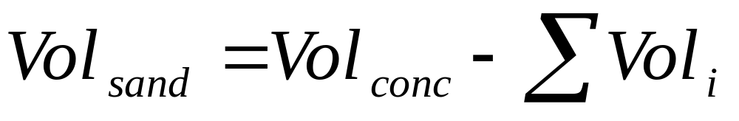
Elements of Concrete Mixture Analysis
Concrete:
Cement
Water
Coarse Aggregate
Fine Aggregate
Air
Mineral Admixtures
Liquid Admixtures
Overall mixture design equation:

Slide 3
Definitions
Yield (Y) = Total volume of concrete
= 1 cy³ or 1 m³ (full batch)
Y_{batch} = Volume of the concrete batch
Volume (V) = W/SG*γ_{water}
w/cm = W_{water}/W_{cementitious} Ratio
BSG = Bulk specific gravity (either
oven dry or SSD)
CAF = Coarse Aggregate Factor
%S = Percent solids
Cement
Factor (CF) = Sacks of cement in a full batch
= 94lbs or 50 kg of cement per sack
DRUW = Dry rodded unit weight
= W_{OD}/Vol_{loose}
Mortar (paste + sand)
Factor (MF) = Vol_{mortar}/Yield = 1 - CAF*%S

Slide 4


Concrete Volumetric Relations
Y
X
Z
CAF =
%S =

Slide 5
Definitions (con’t)
Paste = Cement + water
Water Factor (WF) = Gallons/liters of water per
full batch of concrete
Batch Factor (BF) = Ratio of Y_{full}/Y_{batch}
Concrete Unit Weight = W/V
Laboratory Properties
Bulk Specify Gravity
Absorption Capacity
Dry Rodded Unit Weight
Field Moisture Content
Fineness Modulus/CAF/MF

Slide 6
Calculations
Vol_{w} = W_{water}/62.4
= W_{water}/1000
Vol_{c} = W_{cement}/(3.15* 62.4 )
= W_{cement}/(3.15*1000)
Vol_{CA} = W_{CA}/(BSG_{CA}* 62.4 )
= W_{CA}/(BSG_{CA}*1000)
Vol_{FA} = W_{FA}/(BSG_{FA}* 62.4 )
= W_{FA}/(BSG_{FA}*1000)
CAF = W_{CA}/(Y*DRUW)
%S = DRUW/(BSG_{CA}* 62.4 )
= DRUW/(BSG_{CA}*1000)
Vol_{air} = %Air * Y
MF = (1 - CAF*%S)

Slide 7
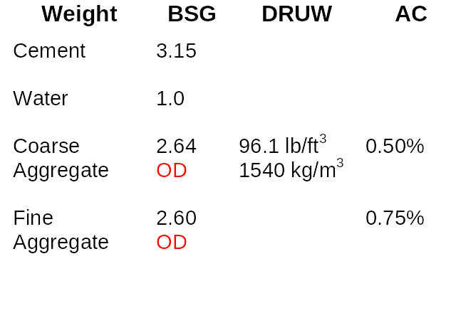
Lab Data

Slide 8
Sample Mix Design
Using the previous material properties, determine the full
sized, SSD mixture proportions (i.e. W_{CA}, W_{w}, W_{FA}, etc.) for:
1) w/c = 0.42; CAF = 0.68;
2) 5% Air
3) 5 sack mix with 20% Fly ash (bsg = 2.30).
1) Calc wt of cement, fly ash, water, and coarse agg
2) Calc vol of cement, fly ash, water, and coarse agg
3) Calc vol and wt of sand

Slide 9
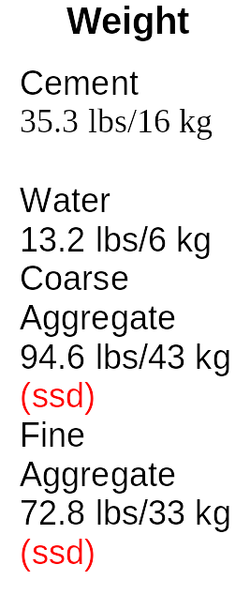
Batch Analysis

Slide 10
Sample Exam Question
Find:
1) w/c, Y_{batch}, CAF, Concrete Unit Weight, Batch
Factor, Cement Factor, and the Mortar Factor
2) Full batch proportions (OD)
3) Concrete unit weight if 6% air is included.

